Slide 1


Slide 2
Web Research & WebQuests

Slide 3
Agenda
Advantages & Disadvantages of Web Research
Search Engines
Trusted Sites
WebQuests Defined
Why WebQuests?
Quality WebQuests
Parts of WebQuests Screen Cast
WebQuest Resource Wiki

Slide 4
Web Research
Advantages
Easy to access masses of data
Disadvantages
Need to trust your source

Slide 5
Search Engines
Google.com
Bing.com
Yahoo.com

Slide 6
Trusted Sites
Type of site
  .com and .net – selling something
  .org and .gov – not as easy to get, more trustworthy
  Keep a list of sites you trust
Who is the author?
Why was the site created?
When was the information updated?

Slide 7
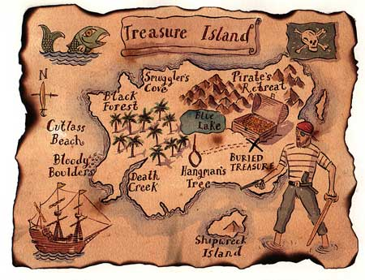
WebQuests
Treasure Hunt on the Internet!
Great resource for teaching content areas in a multidisciplinary approach while simultaneously teaching digital literacy skills.

Slide 8
Why WebQuests?
Students discover for themselves
Students can work at their own pace
Within the limits defined by the teacher, students can go more in-depth
Ideal for learners of different abilities
Teaches the value of research
Teaches computer literacy skills

Slide 9
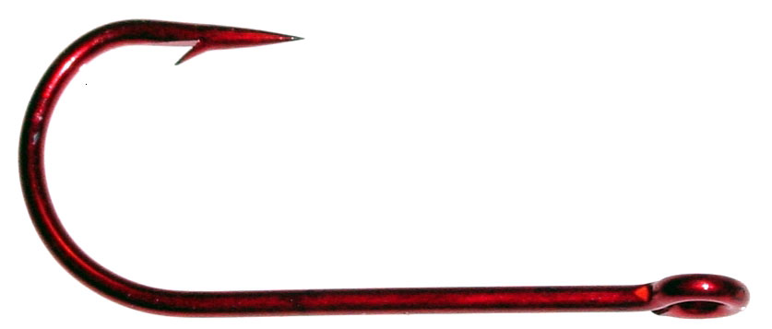
Quality WebQuests
Has a hook
Age appropriate
Easy to use
Relates to the class
Has built in evaluation

Slide 10
Parts of a WebQuest
Screencast on the parts of a WebQuest:
http://screencast-o-matic.com/watch/cXlhbKUNz

Slide 11
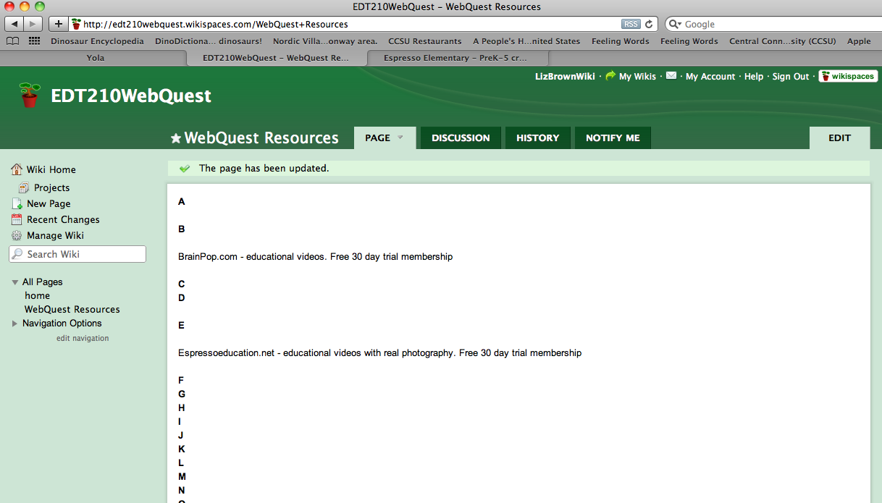
WebQuest Resource Wiki
http://edt210webquest.wikispaces.com/WebQuest+Resources

Slide 12
Image Credits
Treasure Map - http://www.ukoln.ac.uk/services/treasure/
Hook - http://kaishsbjjblog.blogspot.com/2010/07/how-i-would-beat-myself.html

